Slide 1
Principles of Management
Practical Classes
2023/2024

Slide 2
Agenda
Mission, Vision and Values
Examples
Group assignments
Group mission and values
Case distribution
Important information
Creativity exercises

Slide 3
Mission, Vision and Values
Organizations:
Mcdonalds - https://corporate.mcdonalds.com/corpmcd/our-company/who-we-are/our-values.html
Ericsson - https://www.ericsson.com/en/about-us/our-purpose
Paypal - https://about.pypl.com/who-we-are/mission-vision-values/default.aspx

Slide 4
Mission, Vision and Values
Universities:
https://www.iseg.ulisboa.pt/en/about/mission-vision/
https://www.novasbe.unl.pt/en/about-us/our-mission
https://www.iscte-iul.pt/conteudos/iscte/about-us/542/mission-and-vision

Slide 5
Group Assignments
Sit down with your group mates and choose
the group's values, vision, and mission.
Until the next session (20th October is the limit), students should send to the Professor (beatrizjacob@iseg.ulisboa.pt) an A4 sheet with a group photo, full names, student numbers, class, along with the identification of their respective values, vision, and mission.
Notes:
The assessment of the initial assignments will be more tolerant, more gentle, as there hasn't been any previous reference, and there's an advantage in hearing the professor's comments on the other assignments. If no group volunteers to be the first to present... draw lots!

Slide 6
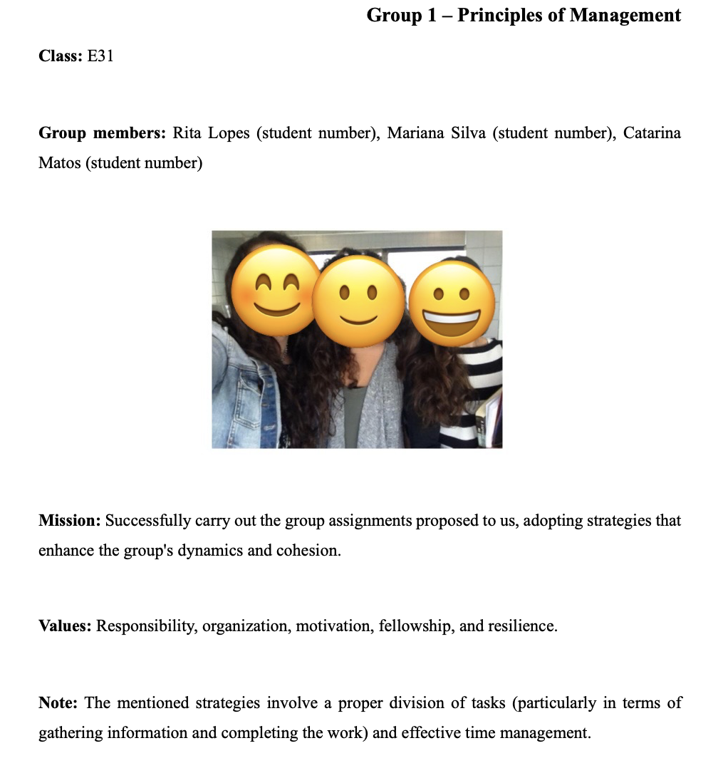
Example

Slide 7
Group Assignments
Cases to be presented and discussed:
1. Diversity and Inclusion
2. Social Responsibility and Ethics
3. Strategy Cases
4. Organizational Design Cases
5. Human Resources Management
Objective: analyze a company's position (ideas, practices, results) regarding the chosen topic.
Notes:
The objective of the case is to analyze a company's position (ideas, practices, results) regarding the chosen topic. The analysis should be based on the concepts presented in the theoretical classes and supported by the most recent information gathered from the most relevant sources.

Slide 8
Group Assignments
The primary sources of information are an interview with an employee of the organization selected by the group.
Other sources:
Official website of the company
Company's official reports
Company publications, academic studies, newspaper articles

Slide 9
Group Assignments
The file containing the written report and the case analysis presentation should be uploaded by the group on Teams with the name "IG_ClassXXX_CaseXXX_analysis.”
For example: "IG_ClassM01_Case1_analysis.”
The subsequent case discussion to be carried out by another group should also be uploaded in the same class team on MS Teams, in digital format (PPT document saved as PDF). Should be named "IG_ClassXXX_CaseXXX_discussion.”
For example: "IG_ClassM01_Case1A_discussion."

Slide 10
Creativity
Exercises
Notes:
Despite that there are individuals with a natural inclination and aptitude for generating new ideas on a particular subject, whatever it may be all students are capable of enhancing their creative performance if they make use of some known techniques for this purpose.

Slide 11
Exercise 1
Individually:
1. Select 4 currently existing products on the market.
2. List a minimum of 3 main features of each of these products.
3. In less than 5 minutes, combine these features (one from each product), and draw a new product that has some application.
This is the method of forced crossing!
(forcing the association of unrelated ideas to increase the probability of finding something new and interesting)

Slide 12
Exercise 2
In a group:
Create a new sports discipline, for which it is necessary to establish 5 basic rules.
This is the method of combinatorial invention!
(a process of trial and error until reaching a successful combination)

Slide 13
Exercise 3
In a group:
Create a name and a slogan for your course at ISEG.
This is the method of brainstorming!
(You start with a topic, a deadline, and participants, and there should be a facilitator who records the ideas and ensures the adherence to the rules:
Generate the greatest number of ideas possible.
Criticizing any idea is not allowed.
Combining ideas is encouraged.
Ideas that may go beyond the expected are encouraged.
In the end, ideas are evaluated until the best one is reached!)

